Slide 1





SMART INDIA HACKATHON 2026
TITLE PAGE
• Problem Statement ID : 26101
• Problem Statement Title : Develop an AI enabled learning platform that identifies competency gaps, recommends personalized training through integration with the iGOT Karmayogi ecosystem, and capable of generating Quizzes and Multiple choice questions (MCQs) from uploaded learning materials to strengthen capacity building in India's Official Statistical System.
• Theme : Smart Education
• PS Category : Software
• Team ID : 163519
• Team Name : F-TECH

Slide 2

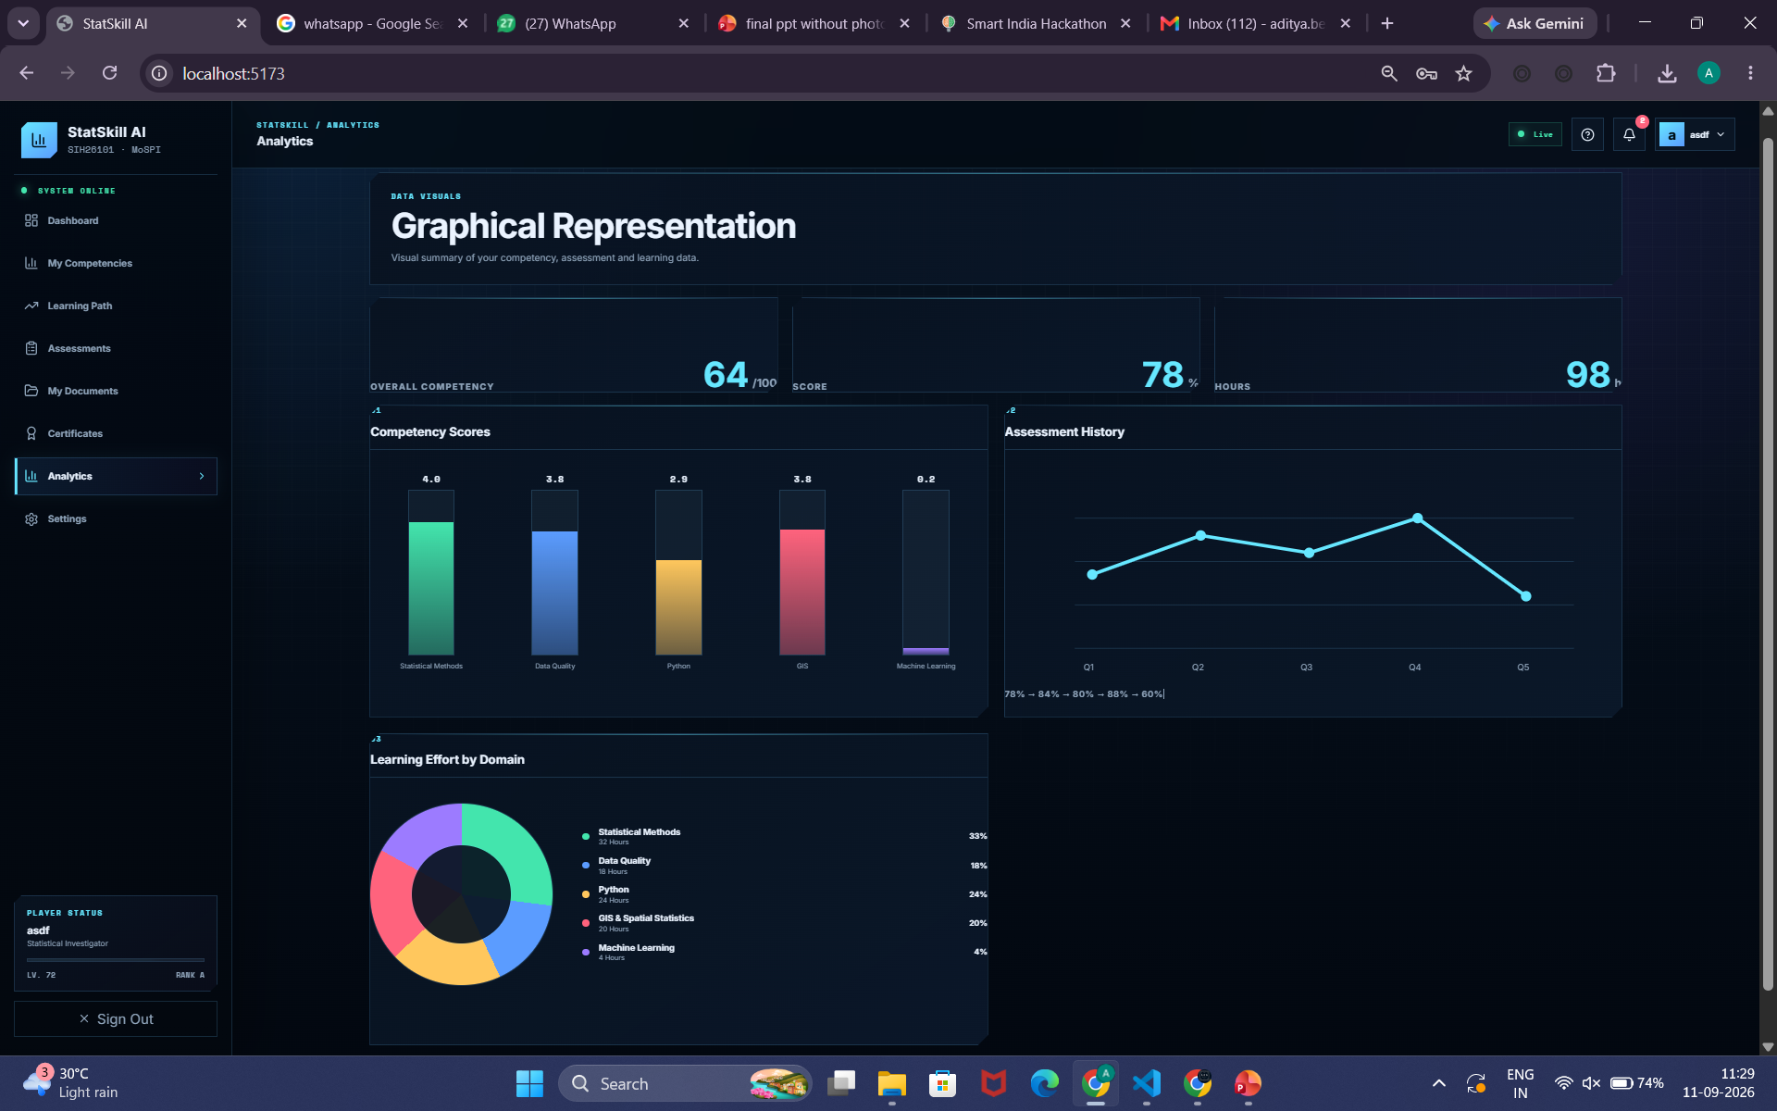
IDEA TITLE
STATSKILL-AI
AI-Powered Competency & Learning Intelligence Platform
WHAT'S MISSING
WHY THIS IDEA?
Learning ≠ Competency Completing a course does not establish what an officer can actually apply . Generic Learning ≠ Personalized Learning Different roles require different competencies and different learning paths.
One-Time Assessment ≠ Continuous Improvement Competency needs to be measured again after learning to track actual progress..
Knowing whether learning actually changes competency . Competency Baseline — What does the officer know today ?
Skill-Gap Intelligence — What does the role require that is missing ? Personalized Learning Path — What should the officer learn next ? Reassessment — Did competency improve after learning ? Continuous Profile Update — What should be recommended next?
WHAT WE ADD
WHAT EXISTS
STATSKILL AI
The competency-intelligence layer that connects learning with measurable improvement.
ASSESS → DIAGNOSE → PERSONALISE → LEARN → REASSESS → IMPROVE
Courses • Learning Resources • Assessments
iGOT Karmayogi screenshot
SMART INDIA HACKATHON 2026
2
Notes:
2

Slide 3
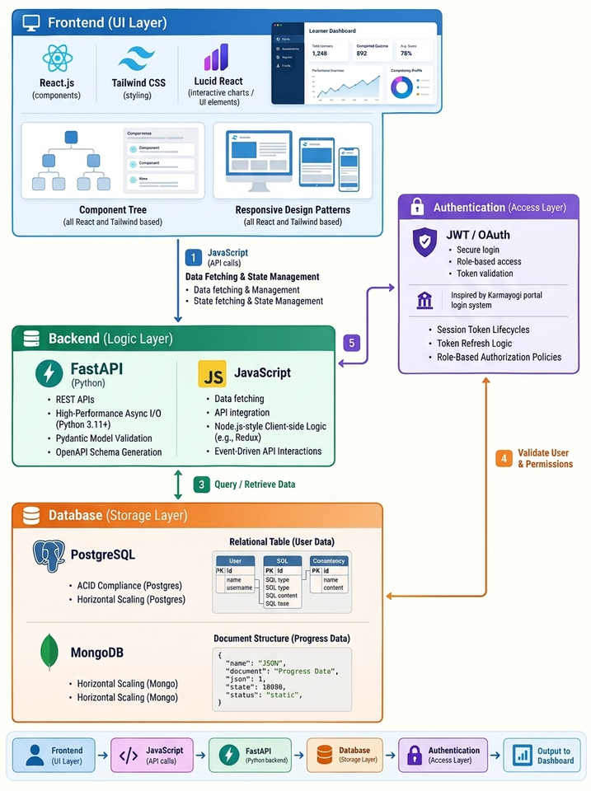
TECHNICAL APPROACH
END-TO-END ARCHITECTURE
Learner / Admin
Content Ingestion
AI Intelligence
Personalization
Assessment Loop
PDF/PPT/DOCX → OCR → chunks
Metadata + competency tags
RAG • Embeddings LLM
Competency Extraction + Gap Scoring
Role • Profile Learning history
Self-assessment Uploads
Gap → Learning Path
Recommend iGOT Resources
AI-generated MCQs
Score → Update Competency Profile
TECHNOLOGY STACK
IMPLEMENTATION METHOD
AI/ML
LLM + Embeddings • Competency Classifier Recommendation Model
MVP
Upload → RAG → MCQ generation → competency gap dashboard
Knowledge
RAG pipeline • vector database • Metadata/competency store
Pilot
Map selected statistical roles/competencies; validate recommendations
Application
Python/FastAPI • React/Angular-style web UI • REST APIs
Integrate
Connect to iGOT learning resources through approved integration mechanisms
Integration
iGOT connector layer • approved APIs/data exchange • SSO where available
Security
RBAC • encryption • audit logs • PII minimization • human review
Scale
Multilingual support, analytics, feedback-driven recommendation tuning
SMART INDIA HACKATHON 2026
3
Notes:
3

Slide 4
FEASIBILITY AND VIABILITY
VIABILITY
FEASIBILITY
VIABILITY
WHY CAN STATSKILL AI ACTUALLY WORK?
WHY DOES THE VALUE CONTINUE?
EXISTING FOUNDATION
Built around iGOT, NSSTA, existing competency frameworks and officer profiles — not a new learning ecosystem.
LEARN → REASSESS → MEASURE → RECOMMEND → LEARN AGAIN
Baseline
Competency assessment establishes where the officer stands.
↓
AVAILABLE INPUTS
Role requirements, competency standards, learning resources and assessment results provide the data needed to identify gaps and measure progress.
Learning
Targeted resources address the identified gap.
↓
Reassessment
Post-learning assessment establishes what changed.
AI AS THE CONNECTING LAYER
AI brings these existing components together to assess → identify gaps → recommend → reassess, making the proposed workflow technically achievable.
↓
Updated Profile
New competency evidence informs the next learning recommendation.
INCREMENTAL IMPLEMENTATION
The system can begin with defined roles and competencies, validate the assessment–recommendation cycle, and then extend to additional roles and departments.
↻ CONTINUOUS LEANING LOOP
Learning completion becomes an input — not the endpoint.
SCALE PATH
DEFINED ROLE → PILOT → VALIDATE → MORE ROLES → MORE DEPARTMENTS
iGOT enables the learning. StatSkill AI makes the learning measurable. From learning delivered → to competency demonstrated.
SMART INDIA HACKATHON 2026
4
Notes:
4

Slide 5
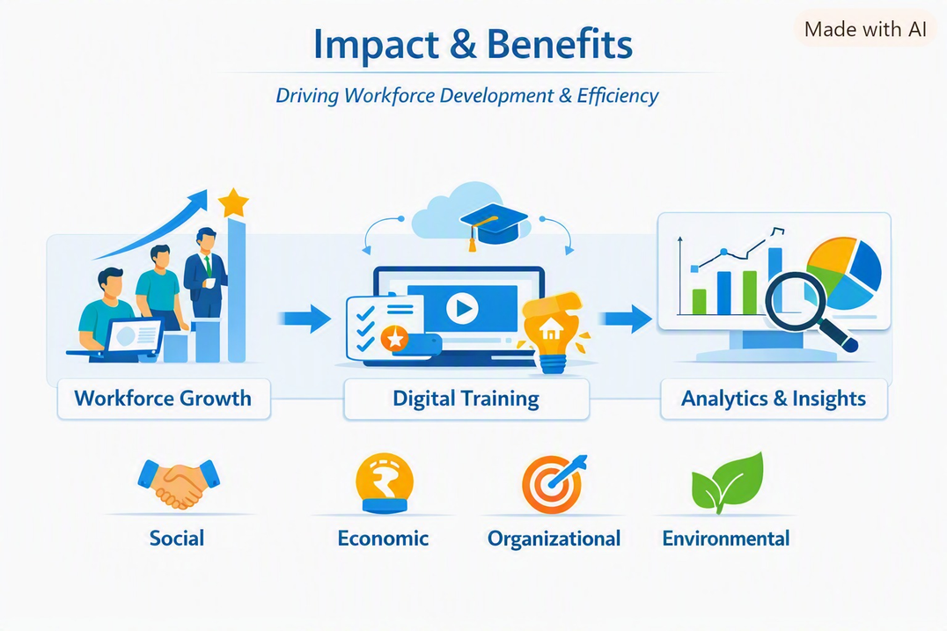
IMPACT AND BENEFITS
🎯 FROM LEARNING TO COMPETENCY
Measure what officers can actually apply — not just what they complete.
👤 FOR THE OFFICER
Personalized learning based on actual competency gaps.
Targeted upskilling instead of one-size-fits-all training.
Continuous feedback through reassessment and progress tracking.
Clear visibility of strengths, gaps and improvement.
🏛️ FOR THE ORGANISATION
Right skills for the right roles.
Data-driven training decisions.
Measurable competency improvement.
Better alignment of learning with departmental priorities.
📊 FOR GOVERNANCE
More capable and future-ready workforce.
Stronger application of statistical competencies.
Continuous capacity building at scale.
Improved effectiveness of public-service delivery.
SMART INDIA HACKATHON 2026
5
Notes:
5

Slide 6
RESEARCH AND REFERENCES
REFERENCE BASE LINKS-:
Smart India Hackathon
SIH2026 Idea Submission
Template
iGot
iGOT Karmayogi — Official
Portal
Karmayogi - Google Drive
Research
Github Repository link
AdityaKymarSharmaAKS/SIH26101_Project
Note: iGOT integration is proposed through approved interfaces; exact API/data-access mechanisms must be validated during implementation.
SMART INDIA HACKATHON 2026
6
Notes:
6

